Slide 1
“We’re All Social Scientists Now”
Introduction to Quantitative Social Science

Slide 2
Do Police Body Cameras Affect the Use of Force?
?
Body Camera
Use of Force

Slide 3
Do Police Body Cameras Affect the Use of Force?
?
Body Camera
Use of Force

Slide 4
Do Police Body Cameras Affect the Use of Force?
?
Body Camera
Use of Force
Naive estimator: E[# uof | body cam] - E[# uof | ~body cam]

Slide 5
Do Police Body Cameras Affect the Use of Force?
Confounders
Body Camera
Use of Force
Examples?

Slide 6
Do Police Body Cameras Affect the Use of Force?
Confounders
Body Camera
Use of Force
Examples?
Consent decree, union, dept policy, officer assignment (e.g. undercover and patrol danger), officer quality, gvt level (fed, state, local), race, age, gender, economic status

Slide 7
Causal Research Design
Experiments
Quasi-experiments
Observational studies

Slide 8
Experiment
Confounders
Body Camera
Use of Force
Researcher randomly assigns body cams

Slide 9
Quasi-Experiment
Confounders
Body Camera
Use of Force
Nature randomly assigns body cams

Slide 10
Observational Study
Confounders
Body Camera
Use of Force
Include confounders in regression

Slide 11
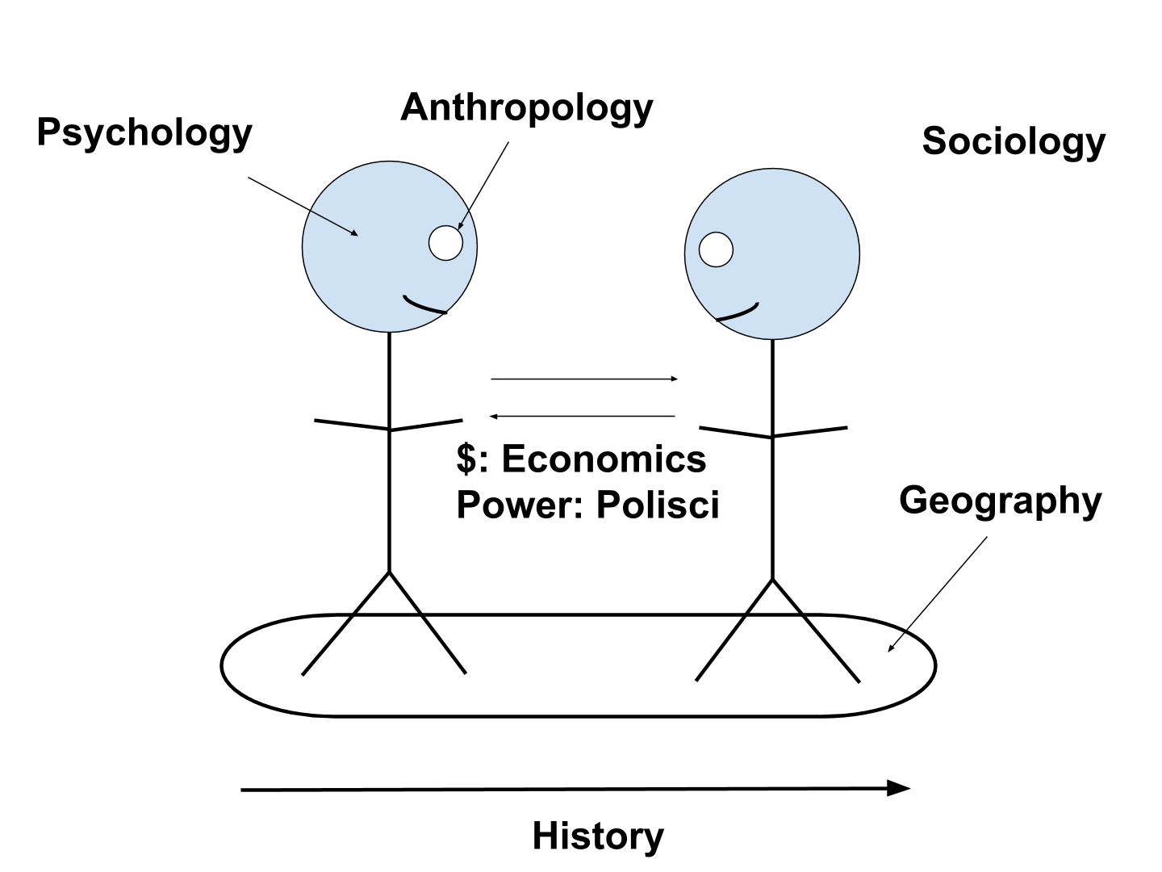

Slide 12
Why Social Science?
We’re interested in people
We want to change behaviors
Privacy, bias, inclusion

Slide 13
Why Social Science?
We’re interested in people
We want to change behaviors
Privacy, bias, inclusion
Social scientists have been thinking about these things for a long time

Slide 14
Why Social Science?
We’re interested in people
We want to change behaviors
Privacy, bias, inclusion
Social scientists have been thinking about these things for a long time
“Statistics”: from “state.” It was meant to improve government.

Slide 15
Machine Learning vs Social Science
 | Machine Learning | Social Science
Primary Goal | Prediction | Explanation
Model Selection | Out-of-sample accuracy | Theory & Parameter Estimates

Slide 16
Body Camera Example
Machine learning example: E[# uof | bodycam, confounders & everything else]
Social science example: E[# uof | bodycam, confounders] - E[# uof | ~bodycam, confounders]

Slide 17
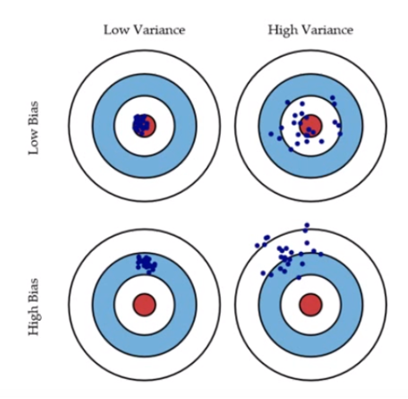
Machine Learning vs Social Science

Slide 18
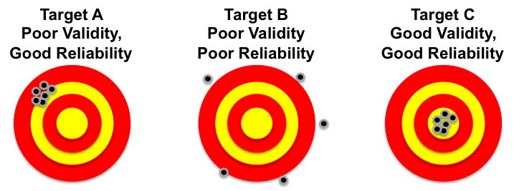
Machine Learning vs Social Science

Slide 19
Machine Learning vs Social Science
Reliability sets the upper bound on validity

Slide 20
Important Social Science Issues
Too few rows
No counterfactuals
External validity: E.g. studying self-control fatigue in the lab
Selection effect: E.g. vulnerable populations are less likely to report police misconduct
Ecological inference
Too many rows
p hacking, in-sample fitting and testing: E.g., flexible post-hoc outlier exclusion
Too few columns
Unobserved variables: E.g. 2013 NFP project: motivation of mothers in/out of the program
Too many columns
Post-treatment controls
Noise
The wrong values
Missing values
Noisy values (e.g. conceptualization - operationalization - measurement)
Systematically biased values
Model specification
Relationship between rows, columns, values, e.g. linear v. non-linear, SUTVA
Ethics
E.g. send mailers placing non-partisan judicial candidates with Montana state seal

Slide 21
Some Lessons Learned for DSSG Projects
Behaviors are better predictors than demographics
Some important predictors
Race
Age
Gender
Econ status
Geography
Some useful datasets
American Community Survey
American Time Use Survey
General Social Survey
Behavioral Risk Factor Surveillance System
Model all people involved (politicians, inspectors, judges, not just defendants)
Potential bias at every step

Slide 22
Social Science Examples
Miller’s Law: 7 +/- 2
Culture of Honor
Invisible Gorilla: Selective Attention
Implicit Association Test
Social Pressure and Voter Turnout
The Michigan Model (partisan ID)
Republicans Should Pray for Rain
The Political Legacy of American Slavery
Effective Messages in Vaccine Promotion
Crime and Punishment
Geography and Trade
Political Economy of Terrorism
Minimum Wages and Employment

